Slide 1

Crime Rate Analysis: A National Overview
This presentation explores crime trends in the US using FBI data from 2022-2023. We analyze key factors influencing rates, including socioeconomic and policy impacts. Get ready for a comprehensive national crime overview.
NK
by Naveen Kumar

Slide 2
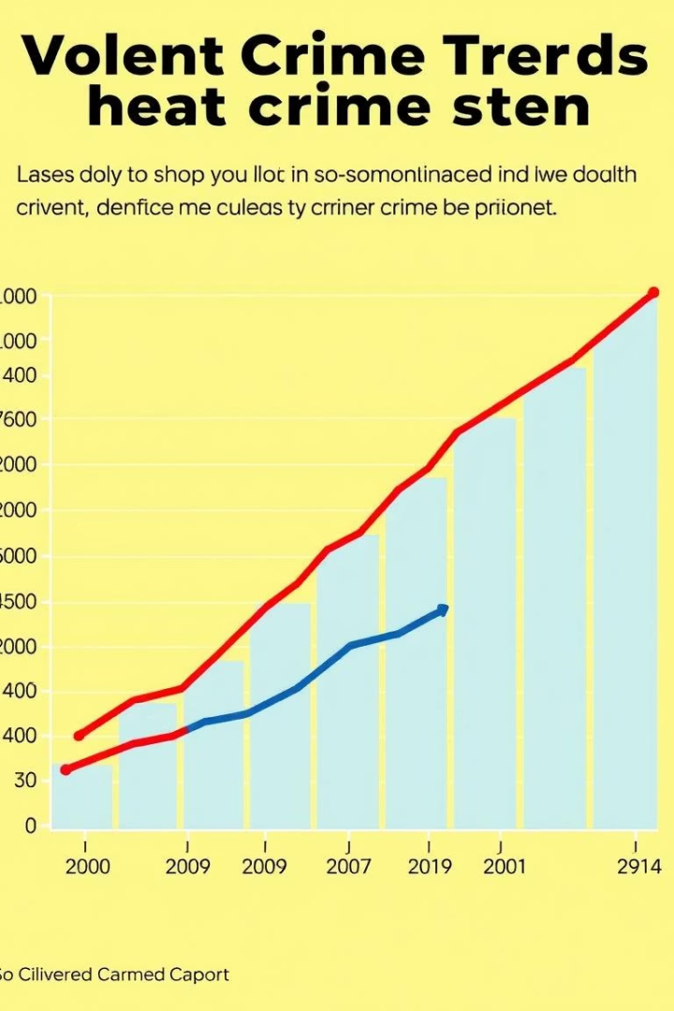
National Crime Trends
Violent Crime
Property Crime
Decreased 1% in 2023, murder down 6.1%, still above 2019 levels
Increased 4%, motor vehicle theft up sharply by 10.9%
Historical Context
Current rates remain lower than crime peaks of the 1990s

Slide 3
Violent Crime Breakdown
Aggravated Assault
Robbery
Rape
Murder
60% of violent crimes
25% of violent crimes
8% of violent crimes
1.6% of violent crimes, 75% involve firearms

Slide 4

Property Crime Analysis
Larceny-Theft
Burglary
Accounts for 70% of property crimes
Represents 18% of property crimes
Motor Vehicle Theft
Arson
Significant increase to 11% of property crimes
Smallest category at 1%
Total property losses reached $17.2 billion in 2022.

Slide 5
Regional Variations
South
Northeast
Midwest
West
Highest violent crime rates nationally
Lowest violent crime rates
Property crime rates near the national average
High violent and property crime in some metro areas
Example: Chicago shows higher violent crime than New York City.

Slide 6
Factors Influencing Crime Rates
Poverty & Inequality
Education
Drug Use & Trafficking
Strong link with crime in urban areas
Lower attainment correlates with higher crime
Influences both violent and property crimes
Policing Strategies
COVID-19 Impact
Community policing vs. broken windows approach
Social disruptions affected crime patterns

Slide 7
Potential Solutions & Interventions
Prevention Programs
Community-based efforts reduce crime opportunities
Education & Job Training
Reduces economic disparities that fuel crime
Criminal Justice Reform
Focuses on racial bias and incarceration rates
Data-Driven Policing
Targets crime hotspots effectively
Mental Health Services
Addresses root causes related to crime behavior

Slide 8

Summary and Future Outlook
Complex Causes
Crime rates influenced by many factors
Data-Driven Solutions
Critical for effective crime reduction
Collaboration
Key between law enforcement, communities, policymakers
Ongoing Monitoring
Essential for adapting strategies and improving safety

Slide 9


